Slide 1
IIITB ML Project: Quora Insincere Questions
Team number- 8
Team name- Runtime Terror
Guide - Nikhil Sai

Slide 2
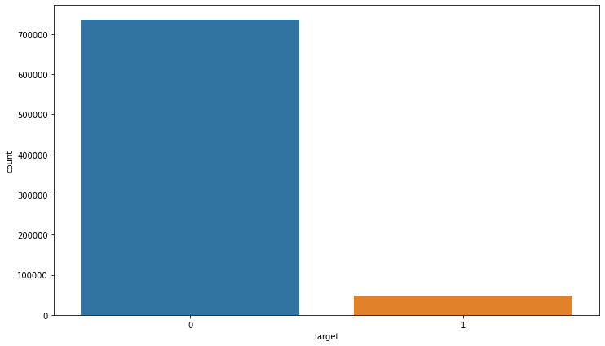
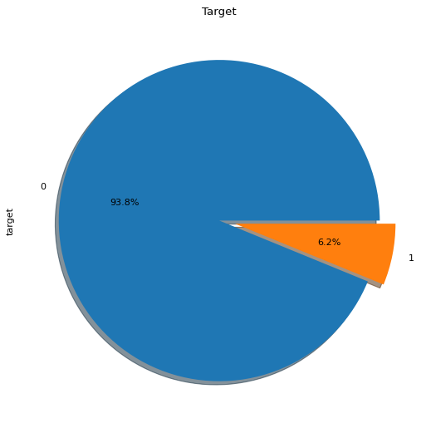
Dataset and Observations
qid - unique question identifier
question_text - Quora question text
target - a question labeled "insincere" has a value of 1, otherwise 0

Slide 3
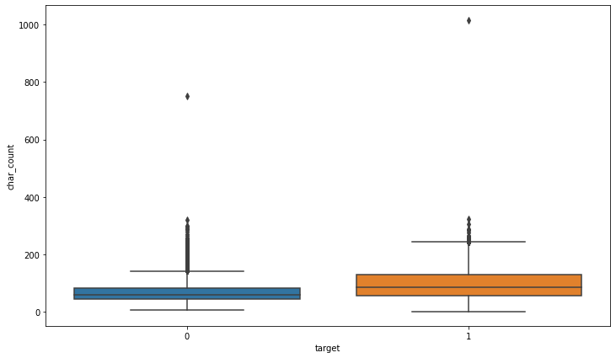
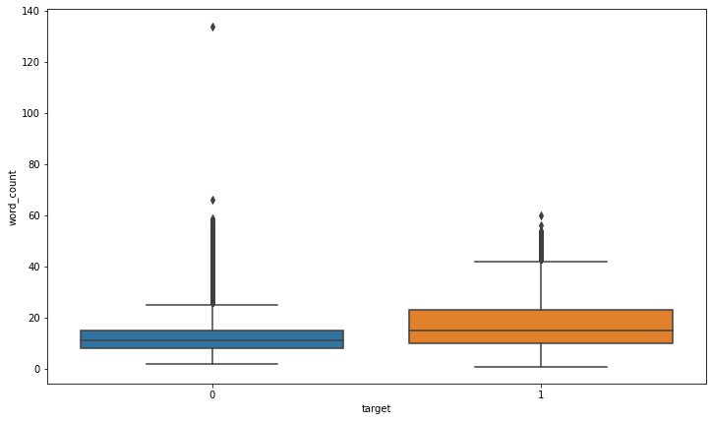
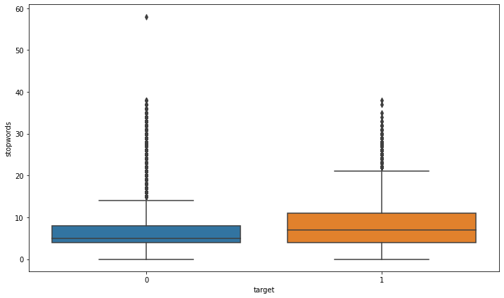

Slide 4
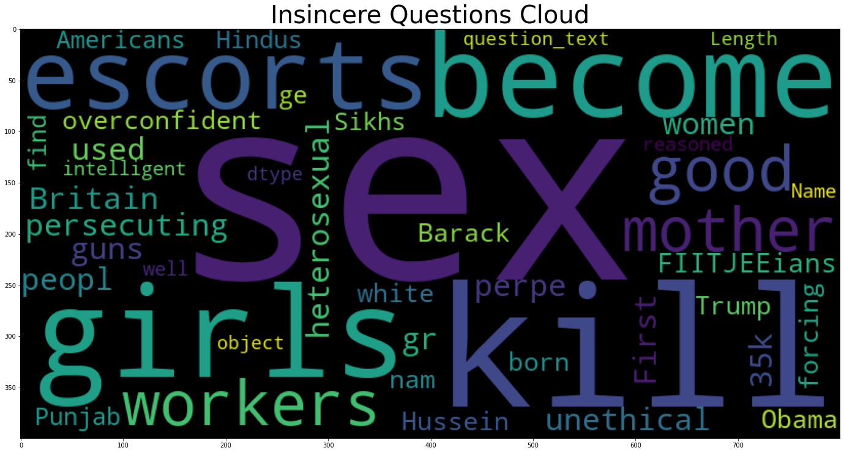
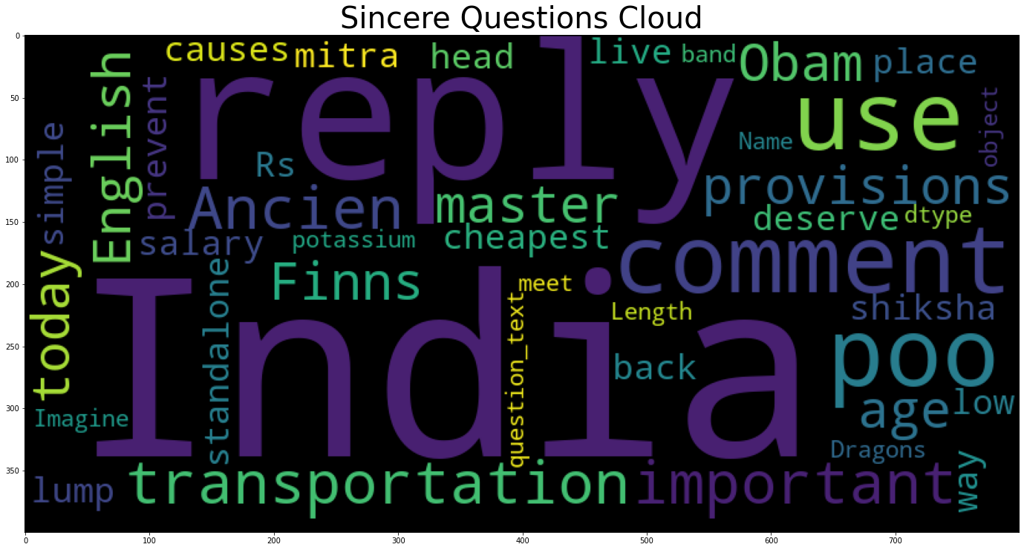

Slide 5
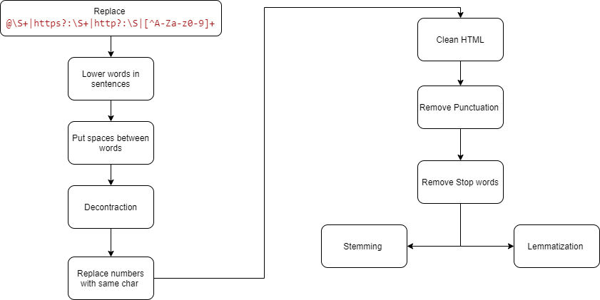
Preprocessing

Slide 6
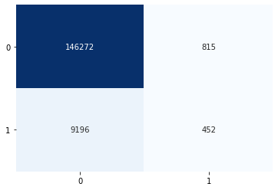
Using EDA Output As Features
Qid | Question text | target | Num words | Num unique words | Num chars | Num stopwords | Num words upper
. . . | . . . | . . . | . . . | . . . | . . . | . . . | . . .

Slide 7
Spelling corrections
Glove embeddings are used to check the coverage i.e checking how many words are in the vocabulary which was around 98%.Using this we also found which words are not in the vocabulary and corrected them manually.
Some examples->
'Qoura': 'Quora',
'citicise': 'criticize',
'wwii': 'world war 2' and many others...

Slide 8
Methodology
First ,feature extraction is done using tf-idf(term frequency inverse document frequency).Which gives sparse matrix as output shape of these matrices are->
(783673, 49549) with n gram (1,1)
(783673, 589377) with n gram (1,4)
(783673,1371570) with n-gram(1,4)*
Now a matrix is created using Naive bayes log count ratio which is multiplied to both tf-idf sparse matrices of train and test data.So we now we have the final data on which we will train our machine learning models.
But some models were performing better without this matrix multiplication

Slide 9
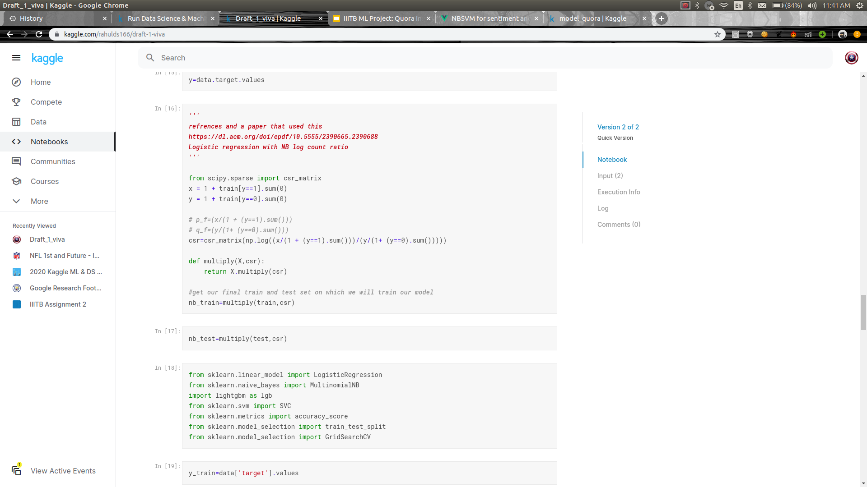
csr=log((ratio of word wrd in class 1)/(ratio of word wrd in class 0))

Slide 10
Machine learning models
Model | Kaggle score(f1_score)
Logistic Regression with SK=20 (two selected) | (without stemming) 0.6336 With stemming=> 0.63525
Voting Classifier | 0.59890
Random forest | 0.47624

Slide 11
More models
Model | Kaggle score
Logistic regression | 0.61207(with grid search),0.57330(Full preprocessing)
Xgboost(With Random Oversampler) | 0.56486
lightgbm | 0.54133
Linear svc | 0.48163

Slide 12
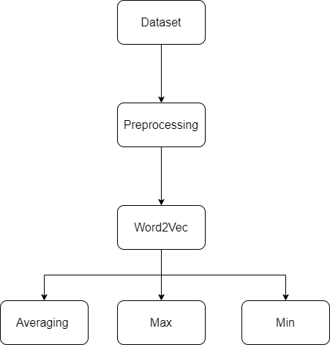
Word2Vec
get | better | deal | with | anxiety | Avg/ Max/ Min
1 | 1 | 1 | 1 | 1
2 | 2 | 2 | 2 | 2
3 | 3 | 3 | 3 | 3
. . . | . . . | . . . | . . . | . . .
99 | 99 | 99 | 99 | 99
100 | 100 | 100 | 100 | 100

Slide 13
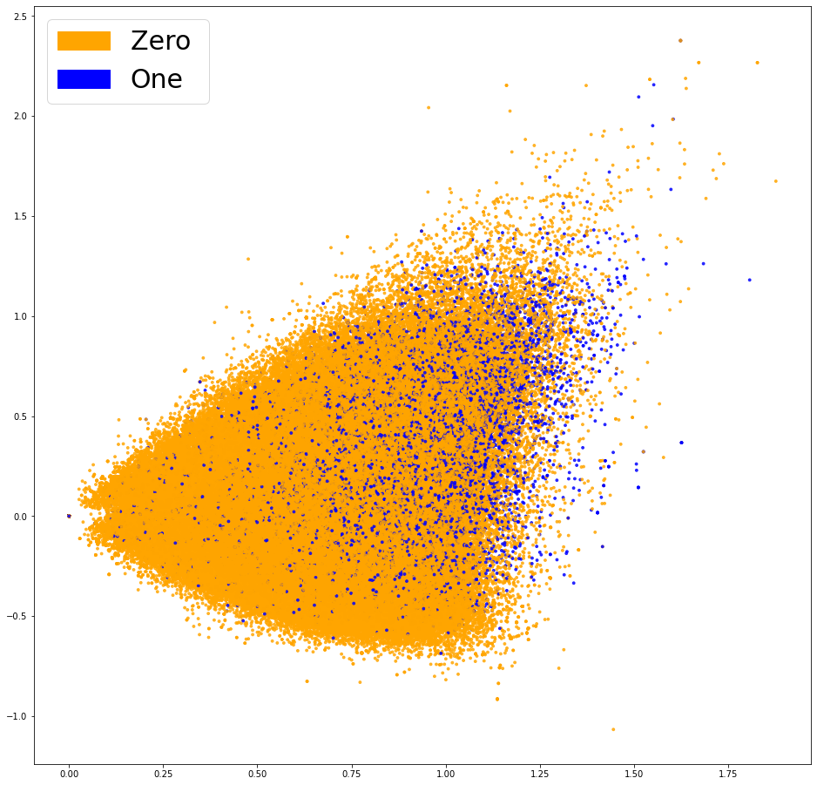
Plot Scatter Graph on Word2vec

Slide 14
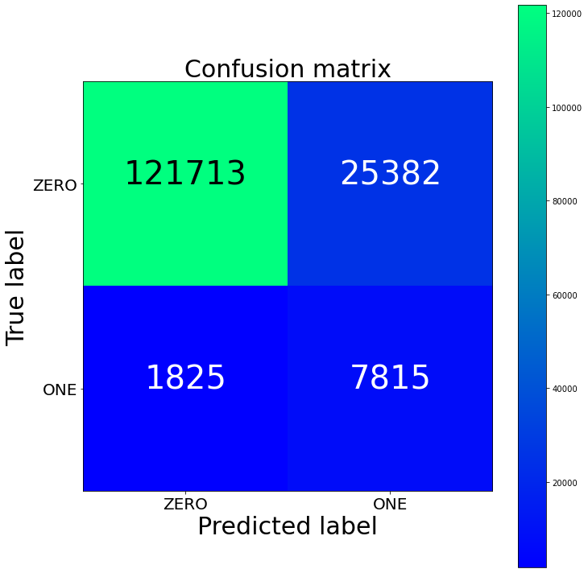
Using Word2Vec Embedding as a feature
Logistic regression
Accuracy : 0.826
Precision : 0.939
Recall : 0.826
F1 : 0.867
accuracy = 0.826, precision = 0.939, recall = 0.826, f1 = 0.867
accuracy =dsd 0.826, precision = 0.hjjjj939, recall = 0.826, f1 = 0.867
accuracy = 0.826, precision = 0.939, recall = 0.826, f1 = 0.867jjj

Slide 15
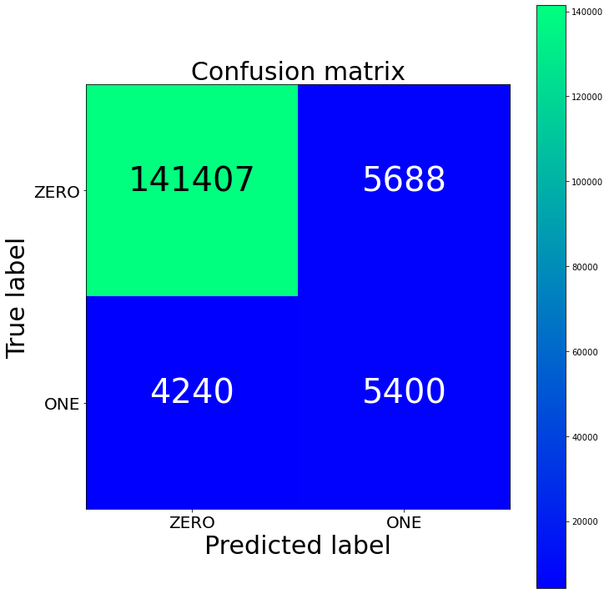
Using TF-idf Embedding as a feature
Logistic regression
Accuracy : 0.937
Precision : 0.941
Recall : 0.937
F1 : 0.939

Slide 16
Tf idf And Word2vec Comparison
MODAL | Tf idf | Word2vec
LogisticRegression | 0.951906083516764 | 0.9393115768654098
RandomForestClassifie | 0.9384949117937921 | 0.9384949117937921
XGBClassifier | 0.9406810859093374 | 0.9598387935903534
MaxVoting | 0.89384949117937921 | 0.8733839293932394
Weighted Averaging | 0.9332428377868763 | 0.9106876543009887

Slide 17
Stacking And Blending
With stacking, the predictions of the meta-model on the test set will be better than the predictions of any of the 3 models alone on the test set.
We use same model in both Stacking and Blending.
We use three model out of five model
LogisticRegression(0.954)
RandomForestClassifie(0.934)
SGDClassifier(0.9154)
LinearScv
XGBClassifier
We use top three model on bases of its accuracy score.

Slide 18
Stacking And Blending
The benefit of blending over stacking is that there is absolute no chance of any information leak here. Whereas in stacking, since we are training the base models on the entire train data, this method is not very robust against information leak.
But we got better accuracy in stacking.as compared to Blending
Stacking | Blending
0.57828 | 0.44632

Slide 19
Conclusion
Without removing stop words and without stemming worked well for logistic regression that gave the best score
XGboost and lightgbm were the only model that were working good after performing random over sampling
Sometimes too much preprocessing is not good
Word2Vec are not too helpfull in our project.
And in last stacking and Blending have not given better accuracy to LogisticRegression

